Slide 1
CSCI2100D Lab 2
Xin CHEN
Department of Systems Engineering and Engineering Management
Chinese University of Hong Kong

Slide 2
Outline
Stack & Queue
Overview of Lab 2 Problems

Slide 3
Outline
Stack & Queue
Overview of Lab 2 Problems

Slide 4
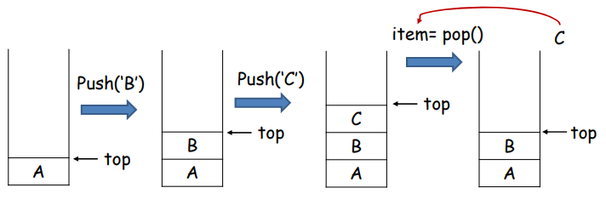
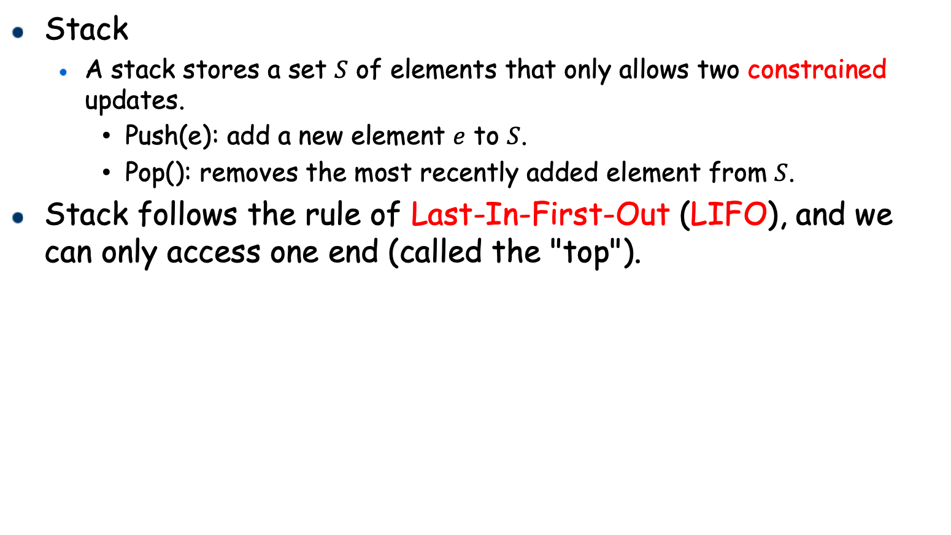
Stack & Queue
Stack
A stack stores a set $S$ of elements that only allows two constrained updates.
Push(e): add a new element $e$ to $S$.
Pop(): removes the most recently added element from $S$.
Stack follows the rule of Last-In-First-Out (LIFO), and we can only access one end (called the "top").

Slide 5
Stack & Queue
Implementing with array:
Value
A | B | C
0 | 1 | 2 | 3 | 4 | 5
Offset
pop()
top
Value
A | B
0 | 1 | 2 | 3 | 4 | 5
Offset
top

Slide 6
Stack & Queue
Implementing with linked list:
∅
(head)
A
B
C
(tail)
∅
pop()
top
∅
(head)
A
B
(tail)
∅
top

Slide 7
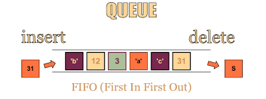
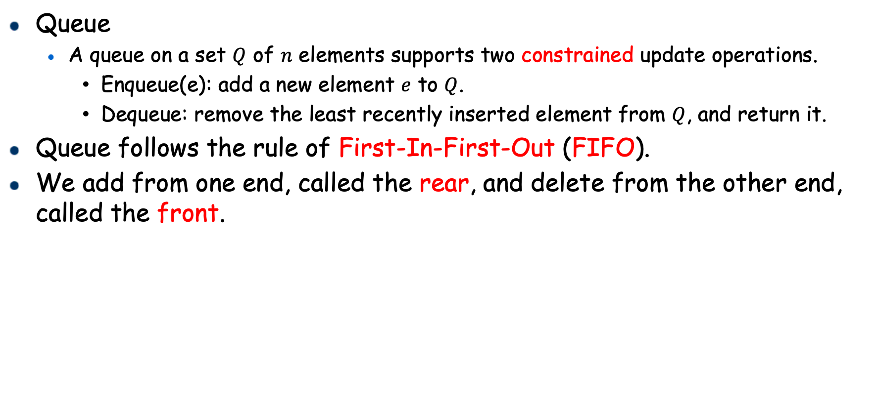
Stack & Queue
Queue
A queue on a set $Q$ of 𝑛 elements supports two constrained update operations.
Enqueue(e): add a new element $e$ to $Q$.
Dequeue: remove the least recently inserted element from $Q$, and return it.
Queue follows the rule of First-In-First-Out (FIFO).
We add from one end, called the rear, and delete from the other end, called the front.

Slide 8
Stack & Queue
Enqueue(Q, ‘B’)
Enqueue(Q, ‘C’)
A queue Q with only one element ‘A’
Enqueue ‘B’ to Q
Enqueue ‘C’ to Q
Dequeue from Q
 | A
 | A | B
front
rear
front
rear
Dequeue(Q)
return A
 | A | B | C
 |  | B | C
front
rear
front
rear

Slide 9
Outline
Stack & Queue
Overview of Lab 2 Problems

Slide 10
Declaration
3 Problems (Required) + 1 Problem (Bonus)
Please add this declaration on the top of all your codes submitted to the OJ.
/*
I, <Your Full Name>, am submitting the assignment for
an individual project.
I declare that the assignment here submitted is original except for source material explicitly acknowledged, the piece of work, or a part of the piece of work has not been submitted for more than one purpose (i.e., to satisfy the requirements in two different courses) without declaration. I also acknowledge that I am aware of University policy and regulations on honesty in academic work, and of the disciplinary guidelines and procedures applicable to breaches of such policy and regulations, as contained in the University website http://www.cuhk.edu.hk/policy/academichonesty/.
It is also understood that assignments without a properly signed declaration by the student concerned will be graded as zero by the teacher(s).
*/

Slide 11
Problem 1
Implement Stack with Array
Use the provided code template, complete the missing part.
Description:
Implement the stack ADT with the array.
Input:
The first line contains one integer which is capacity.
The second line contains one integer: N.
The next N lines, each of which contains an operation: push x (an Integer) or top or pop or isFull or isEmpty.
Output:
Each line is the warning or result of Top
Sample Input 1: Sample Output 1:
2 Full!!!!
9 2
push 1 Full!!!!
push 2 1
push 3 Empty!!!
top
isFull
pop
top
pop
isEmpty

Slide 12
Problem 1
Implement Stack with Array (cont.)
Complete the stack ADT.
StackADT CreateStack(int capacity);
// return 1 if it is true, or 0 otherwise
int IsEmpty(StackADT s);
// return 1 if it is true, or 0 otherwise
int IsFull(StackADT);
void Push(StackADT s, int value)
{ // write down your code here }
void Pop(StackADT s)
{ // write down your code here }
int Top(StackADT s)
{
// write down your code here
// If it is empty, you should return INF.
}
struct stack {
int capacity;
int size;
int* arr;
};
typedef struct stack* StackADT;
#define INF -1

Slide 13
Problem 2
Implement Queue with Linked List
Use the provided code template, complete the missing part.
Description:
Implement the queue ADT with the linked list.
Input:
The first line contains one integer which is capacity.
The second line contains one integer: N.
The next N lines, each of which contains an operation: enqueue x (an Integer) or dequque or isFull or isEmpty.
Output:
Each line is the warning or result of Dequeue
Sample Input 1: Sample Output 1:
2 Full!!!!
7 4
enqueue 4 Not Full
enqueue 5 5
enqueue 6 Empty!!!
dequeue
isFull
dequeue
isEmpty

Slide 14
Problem 2
Implement Queue with Linked list (cont.)
Complete the queue ADT.
struct queueNode {
int value;
struct queueNode* next;
struct queueNode* prev;
};
typedef struct queueNode* QueueNode;
struct queue {
int capacity;
int size;
QueueNode head;
QueueNode tail;
};
typedef struct queue* QueueADT;
#define INF -1
QueueNode AllocateEmptyQueueNode();
QueueADT CreateQueue(int capacity);
// return 1 if it is true, or 0 otherwise
int IsEmpty(QueueADT q);
// return 1 if it is true, or 0 otherwise
int IsFull(QueueADT q);
void Enqueue(QueueADT q, int value)
{ // write down your code here }
int Dequeue(QueueADT q)
{ // write down your code here
// If it is empty, you should return INF.
}

Slide 15
Problem 3
Implement Queue with Two Stacks
Use the provided code template, complete the missing part.
Description:
Implement the queue ADT with two stacks.
Input:
The first line contains one integer which is capacity.
The second line contains one integer: N.
The next N lines, each of which contains an operation: enqueue x (an Integer) or dequque or isFull or isEmpty.
Output:
Each line is the warning or result of Dequeue
Sample Input 1: Sample Output 1:
2 Full!!!!
7 4
enqueue 4 Not Full
enqueue 5 5
enqueue 6 Empty!!!
dequeue
isFull
dequeue
isEmpty

Slide 16
Problem 3
Implement Queue with Two Stacks (cont.)
Complete the queue ADT.
struct stack {
int capacity;
int size;
int* arr;
};
typedef struct stack* StackADT;
struct queue {
int capacity;
int size;
StackADT s1;
StackADT s2;
};
typedef struct queue* QueueADT;
#define INF -1
StackADT CreateStack(int capacity);
int IsStackEmpty(StackADT s);
int IsStackFull(StackADT s);
void Push(StackADT s, int value)
{ // write down your code here }
void Pop(StackADT s)
{ // write down your code here }
int Top(StackADT s)
{ // write down your code here }
QueueADT CreateQueue(int capacity);
// return 1 if it is true, or 0 otherwise
int IsQueueEmpty(QueueADT q);
// return 1 if it is true, or 0 otherwise
int IsQueueFull(QueueADT q);
void Enqueue(QueueADT q, int value)
{ // write down your code here }
int Dequeue(QueueADT q)
{ // write down your code here
// If it is empty, you should return INF.
}

Slide 17
Problem 4 (Bonus)
Unblocked Buildings Ahead
Use the provided code template, complete the missing part.
Hint: Try using stack to solve this problem.
Hint: It should run in O(n) total time.
Description:
Given a series of the height of buildings, for each buildings, please calculate the number of unblocked buildings it can see ahead.
We say that the i-th building with the height h_i is blocked by the j-th building with the height h_j only if i < j and h_i <= h_j.
The unblocked building (the j-th building) that the i-th building can see ahead satisfies: (1) j < i (2) not blocked by any k-th buildings with k < i.
You must write an algorithm that runs in O(n) total time.
Input:
First line contains one integer N;
The second line contains N integers, h_0, h_1, …, h_(N-1), each of which is the height of each buildings;
Output:
N integers, each of which is the number of unblocked buildings that the i-th building can see ahead.
Sample Input 1: Sample Output 1:
8 0
5 3 8 3 2 5 5 5 1
2
1
2
3
2
2

Slide 18
Problem 4 (Bonus)
Unblocked Buildings Ahead (cont.)
Example
Sample Input 1: Sample Output 1:
8 0
5 3 8 3 2 5 5 5 1
2
1
2
3
2
2
The 3-th building can see 2 unblocked buildings ahead!!
5
3
8

Slide 19
Problem 4 (Bonus)
Unblocked Buildings Ahead (cont.)
Example
The 5-th building can see 2 unblocked buildings ahead, which are the 3-th and 4-th buildings.
Sample Input 1: Sample Output 1:
8 0
5 3 8 3 2 5 5 5 1
2
1
2
3
2
2
5
3
8
3
2

Slide 20
Problem 4 (Bonus)
The 6-th building can see 3 unblocked buildings ahead, which are the 3-th, 4-th, and 5-th buildings.
Unblocked Buildings Ahead (cont.)
Example
Sample Input 1: Sample Output 1:
8 0
5 3 8 3 2 5 5 5 1
2
1
2
3
2
2
5
3
8
3
2
5

Slide 21
Problem 4 (Bonus)
The 8-th building can see 2 unblocked buildings ahead, which are the 3-t and 7-th buildings.
Unblocked Buildings Ahead (cont.)
Example
Sample Input 1: Sample Output 1:
8 0
5 3 8 3 2 5 5 5 1
2
1
2
3
2
2
5
3
8
3
2
5
5
5

